Slide 1
Embeddings
Between Dimensionality Reduction and Feature Engineering
Tomasz Chabinka
Senior Data Scientist @ Alior Bank

Slide 2
Dimensionality Reduction
for Sentiment Analysis

Slide 3
Sentiment Analysis
Let’s try to asses sentiment of Harari’s “21 Lessons for the 21st Century” reviews:
“There's a few good chapters but this is not a great read and a long way from his better work” ⭐⭐
“Would make a good light hearted documentary with Alan Partridge” ⭐⭐⭐
“I enjoyed the reading though, especially the sections where he is looking at today's issues, but the last chapter about meditation seemed to be rather bolted on and disconnected to the rest of the book” ⭐⭐⭐⭐

Slide 4
Sentiment Analysis: First Try
We can use bag-of-word representation for our sentences :
Number of features: 400K - 2.2M Other problems: it’s lacking context, not all the words in training dataset
few | field | ... | goal | good | government | great | ... | not
1 | 0 |  | 0 | 1 | 0 | 1 |  | 1

Slide 5
Sentiment Analysis: Second Try (a)
We can use bag-of-word representation (hot-encode) each word :
Number of features: 400K * 5 (= 2M) - 2.2M * 30 (= 66 M)
few | field | ... | goal | good | government | great | ... | not
1 | 0 | ... | 0 | 0 | 0 | 0 | ... | 0
0 | 0 | ... | 0 | 1 | 0 | 0 | ... | 0
... | ... | ... | ... | ... | ... | ... | ... | ...
0 | 0 | ... | 0 | 0 | 0 | 0 | ... | 1
0 | 0 | ... | 0 | 0 | 0 | 1 | ... | 0

Slide 6
Sentiment Analysis: Second Try (b)
We could try to reduce dimensionality with:
subset selection,
shrinkage methods (regularization),
dimension reduction methods (e.g. Principal Component Analysis) [1]
but it won’t work 😞

Slide 7
Sentiment Analysis: Embeddings to the Rescue
With word embeddings we can encode each token with ~300 features:
2M vs 1.5K (1333.3:1 ratio)
66M vs 9K (7333.3:1 ratio)
And it will help with rare words too!

Slide 8
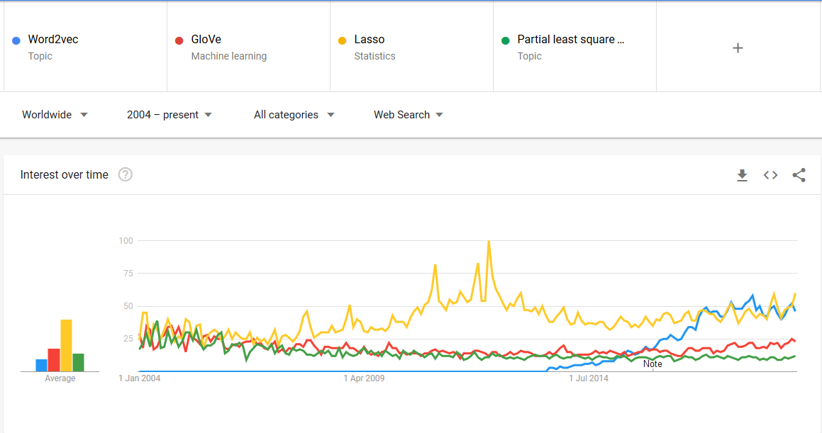
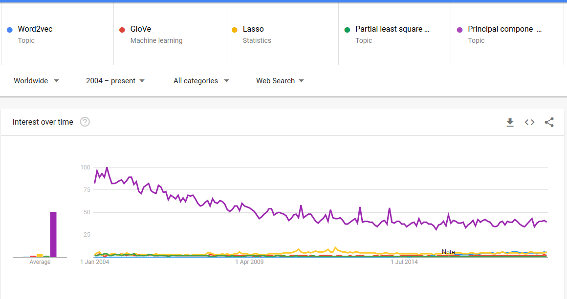
Popularity of dimensionality reduction techniques*
Word2Vec / GloVe / Lasso / Partial Least Squares...
...Principal Component Analysis
* according to Google Trends

Slide 9
Feature Engineering
for recommender systems

Slide 10
Feature Engineering
Let’s say we are building discount coupons app and we want to predict to which shops we should grant coupons to each user based on shops the user visited in the past

Slide 11








Feature Engineering: First Try
Good Value to Money
Popular
Prestigious
Premium
One approach would be to try and describe each shop, so we’re able to find similar ones. Drawbacks: it may be hard to describe thousands of shops; it requires a lot of expertise

Slide 12
Feature Engineering: Embeddings to the Rescue
1st dimension
2nd dimension
Embeddings will learn useful features from categorical data you provide. Usually embeddings will learn around useful ∜n features, where n is a number of items in your problem (e.g. words, shops)

Slide 13
Feature Engineering: Embeddings to the Rescue
1st dimension
2nd dimension
We are not able to interpret dimensions, but: * similar items are close to each other * we can do math at vectors we have, e.g.: toyota - samsung + apple = mercedes

Slide 14
embeddings: a categorical feature represented as a continuous-valued feature. Typically, an embedding is a translation of a high-dimensional vector into a low-dimensional space
embedding space: the d-dimensional vector space that features from a higher-dimensional vector space are mapped to. Ideally, the embedding space contains a structure that yields meaningful mathematical results; for example, in an ideal embedding space, addition and subtraction of embeddings can solve word analogy tasks
Source: Google Developer’s Machine Learning Glossary (https://developers.google.com/machine-learning/glossary/#embeddings)

Slide 15
How to train embeddings?
Word2Vec, GloVe and Recommender Systems

Slide 16
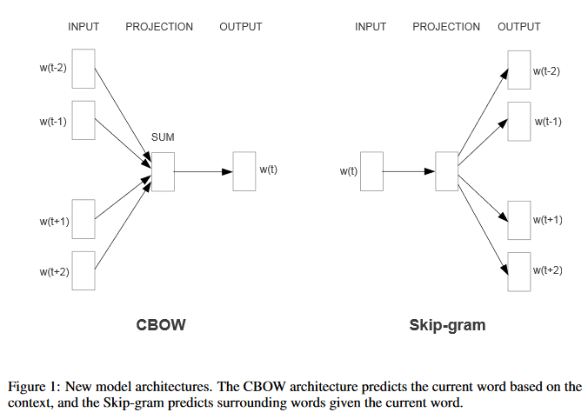
Word2Vec
Source: Mikolov et. al., 2013. Efficient estimation of word representations in vector space (https://arxiv.org/pdf/1301.3781.pdf)

Slide 17
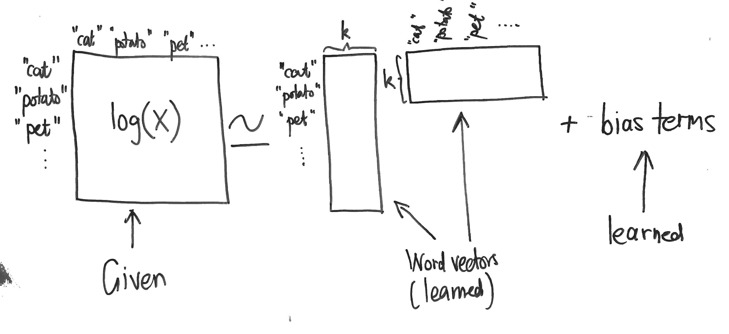
GloVe
Source: http://building-babylon.net/2015/07/29/glove-global-vectors-for-word-representations/

Slide 18
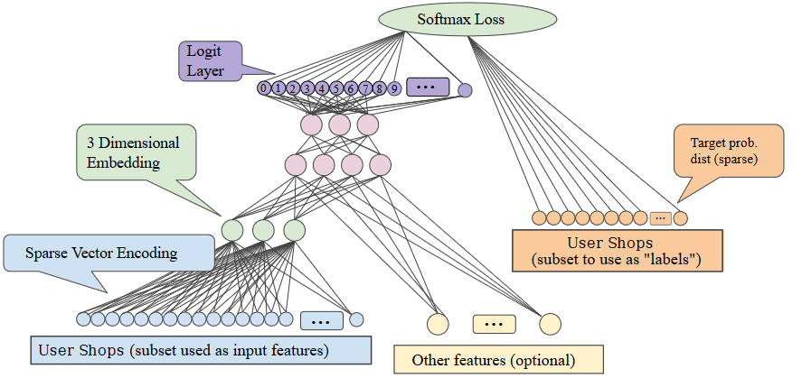
Recommender System
Source: https://developers.google.com/machine-learning/crash-course/embeddings/obtaining-embeddings (modified)

Slide 19
Why all the fuss?

Slide 20
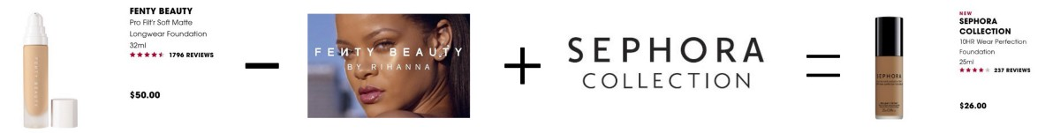
Why to use embeddings?
To find similar items
To calculate relationships between items
For transfer learning
Source: https://towardsdatascience.com/collaborative-embeddings-for-lipstick-recommendations-98eccfa816bd

Slide 21
Tensorflow
embedding_column example

Slide 22
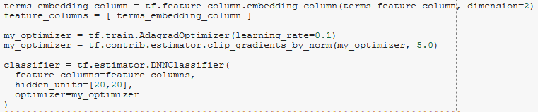
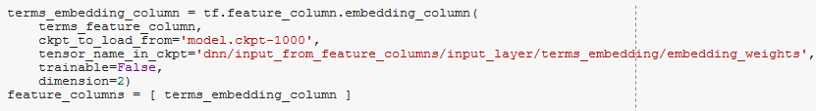
tf.feature_column.embedding_column
Source: https://colab.research.google.com/notebooks/mlcc/intro_to_sparse_data_and_embeddings.ipynb (modified)

Slide 23


Q&A
Check job openings @ Alior Bank [PL]: https://tinyurl.com/alior-it Apply to our acceleration program: https://www.accelerator.aliorbank.pl
Please fill in short feedback form: https://tinyurl.com/pyconlt-embeddings
Stay in touch: tomaszchabinka@gmail.com https://www.linkedin.com/in/tomaszchabinka/

Slide 24
Bonus #1
Gensim Word2Vec

Slide 25
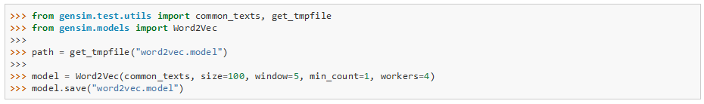
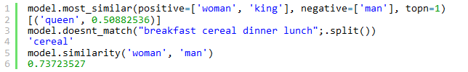
Gensim Word2Vec
Sources: https://radimrehurek.com/gensim/models/word2vec.html https://rare-technologies.com/word2vec-tutorial/

Slide 26
Bonus #2
Bias in Word Embeddings

Slide 27

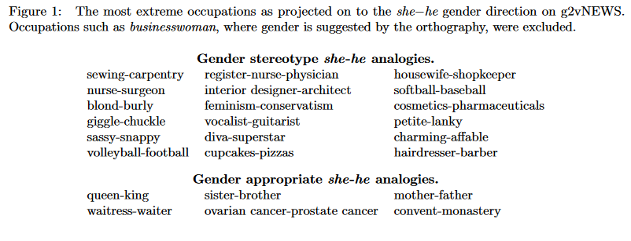
Bias in Word Embeddings
Source: Bolukbasi et. al., 2016. Man is to computer programmer as woman is to homemaker? Debiasing word embeddings https://arxiv.org/abs/1607.06520

Slide 28
Bias in Word Embeddings
Goals when debiasing:
Reduce bias:
Ensure that gender neutral words such as nurse are equidistant between gender pairs such as he and she.
Reduce gender associations that pervade the embedding even among gender neutral words.
Maintain embedding utility:
Maintain meaningful non-gender-related associations between gender neutral words, including associations within stereotypical categories of words such as fashion-related words or words associated with football.
Correctly maintain definitional gender associations such as between man and father
Source: Bolukbasi et. al., 2016. Man is to computer programmer as woman is to homemaker? Debiasing word embeddings https://arxiv.org/abs/1607.06520

Slide 29
Bias in Word Embeddings
Steps:
Identifying the gender subspace (gender direction)
Neutralize - ensures that gender neutral words are zero in the gender subspace
Equalize - perfectly equalizes sets of words outside the subspace and thereby enforces the property that any neutral word is equidistant to all words in each equality set.
For instance, if {grandmother,grandfather} and {guy,gal} were two equality sets, then after equalization babysit would be equidistant to grandmother and grandfather and also equidistant to gal and guy, but presumably closer to the grandparents and further from the gal and guy. This is suitable for applications where one does not want any such pair to display any bias with respect to neutral words.
Source: Bolukbasi et. al., 2016. Man is to computer programmer as woman is to homemaker? Debiasing word embeddings https://arxiv.org/abs/1607.06520

